Slide 1
DIFFIE HELLMAN KEY EXCHANGE PROTOCOL
ONE TIME PAD

Slide 2
DIFFIE HELLMAN KEY EXCHANGE PROTOCOL
Diffie–Hellman key exchange is a mathematical method of securely exchanging cryptographic keys over a public channel and was one of the first public-key protocols as conceived by Ralph Merkle and named after Whitfield Diffie and Martin Hellman.[DH is one of the earliest practical examples of public key exchange implemented within the field of cryptography. Published in 1976 by Diffie and Hellman, this is the earliest publicly known work that proposed the idea of a private key and a corresponding public key.

Slide 3
Traditionally, secure encrypted communication between two parties required that they first exchange keys by some secure physical means, such as paper key lists transported by a trusted courier. The Diffie–Hellman key exchange method allows two parties that have no prior knowledge of each other to jointly establish a shared secret key over an insecure channel. This key can then be used to encrypt subsequent communications using a symmetric-key cipher.

Slide 4
Diffie–Hellman is used to secure a variety of Internet services. However, research published in October 2015 suggests that the parameters in use for many DH Internet applications at that time are not strong enough to prevent compromise by very well-funded attackers, such as the security services of some countries.[

Slide 5
Diffie–Hellman key exchange establishes a shared secret between two parties that can be used for secret communication for exchanging data over a public network. An analogy illustrates the concept of public key exchange by using colors instead of very large numbers:
The process begins by having the two parties, Alice and Bob, publicly agree on an arbitrary starting color that does not need to be kept secret. In this example, the color is yellow. Each person also selects a secret color that they keep to themselves – in this case, red and cyan. The crucial part of the process is that Alice and Bob each mix their own secret color together with their mutually shared color, resulting in orange-tan and light-blue mixtures respectively, and then publicly exchange the two mixed colors. Finally, each of them mixes the color they received from the partner with their own private color. The result is a final color mixture (yellow-brown in this case) that is identical to their partner's final color mixture.
If a third party listened to the exchange, they would only know the common color (yellow) and the first mixed colors (orange-tan and light-blue), but it would be very hard for them to find out the final secret color (yellow-brown). Bringing the analogy back to a real-life exchange using large numbers rather than colors, this determination is computationally expensive. It is impossible to compute in a practical amount of time even for modern supercomputers.

Slide 6
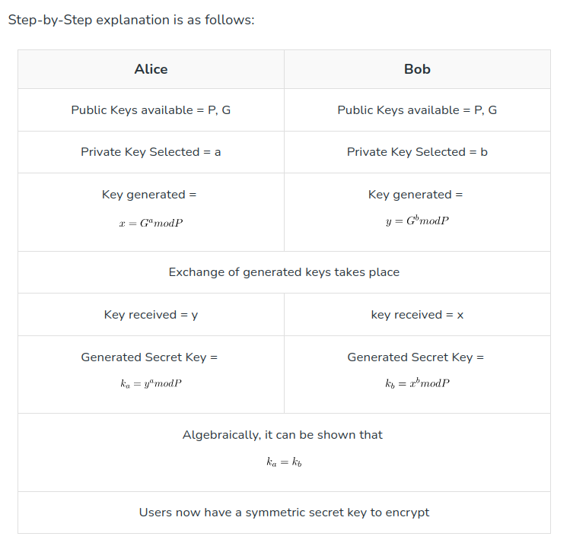

Slide 7
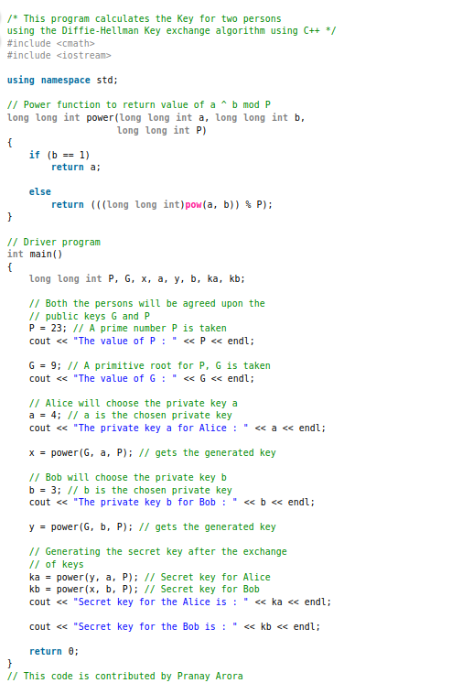
from geekaforgeeks

Slide 8
one-time pad
In cryptography, the one-time pad (OTP) is an encryption technique that cannot be cracked, but requires the use of a single-use pre-shared key that is larger than or equal to the size of the message being sent. In this technique, a plaintext is paired with a random secret key (also referred to as a one-time pad). Then, each bit or character of the plaintext is encrypted by combining it with the corresponding bit or character from the pad using modular addition.

Slide 9
The resulting ciphertext will be impossible to decrypt or break if the following four conditions are met:
1. The key must be at least as long as the plaintext.
2. The key must be random (uniformly distributed in the set of all possible keys and independent of the plaintext), entirely sampled from a non-algorithmic, chaotic source such as a hardware random number generator; patternless, according to Gregory Chaitin definition.It is not sufficient for OTP keys to pass statistical randomness tests as such tests cannot measure entropy, and the number of bits of entropy must be at least equal to the number of bits in the plaintext. For example, using an algorithm to generate seemingly-random data would allow an attacker to try to crack the random number generation algorithm. Truly random data by definition cannot be predicted.
3. The key must never be reused in whole or in part.
4. The key must be kept completely secret by the communicating parties.

Slide 10
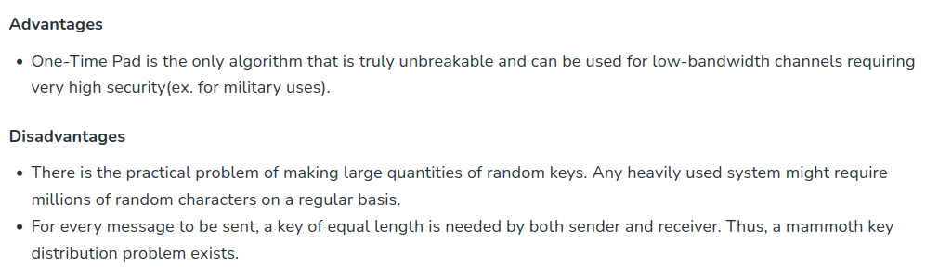
It has also been mathematically proven that any cipher with the property of perfect secrecy must use keys with effectively the same requirements as OTP keys.[Digital versions of one-time pad ciphers have been used by nations for critical diplomatic and military communication, but the problems of secure key distribution make them impractical for most applications.
The "pad" part of the name comes from early implementations where the key material was distributed as a pad of paper, allowing the current top sheet to be torn off and destroyed after use. For concealment the pad was sometimes so small that a powerful magnifying glass was required to use it. The KGB used pads of such size that they could fit in the palm of a hand,or in a walnut shell To increase security, one-time pads were sometimes printed onto sheets of highly flammable nitrocellulose, so that they could easily be burned after use.

Slide 11
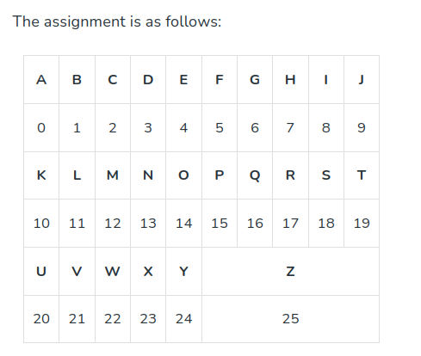

Slide 12
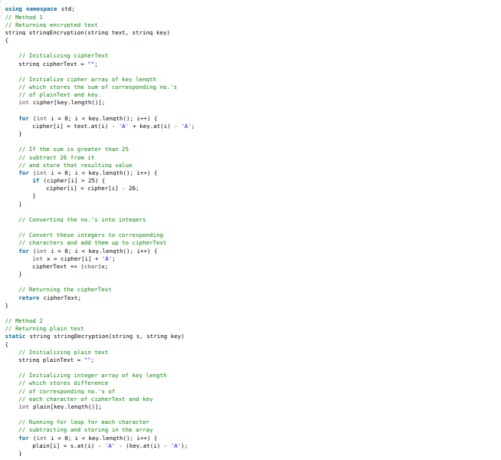

Slide 13
